Slide 1
Our school system in Slovakia
Presentation prepared by students from 9th grade.

Slide 2
Types of Schools and school system
We have three types of schools we attend during our lives:
Elementary School: 6-15
High School: 15-18/19
University: 18/19-25 and more
Our Elemetary School is divided into two levels:
First level is Grade School (6-10)
Second level is Junior High School i.e. Middle School (10-15)
Our school lesson lasts 45 minutes and breaks last cca. 5-15 minutes.

Slide 3
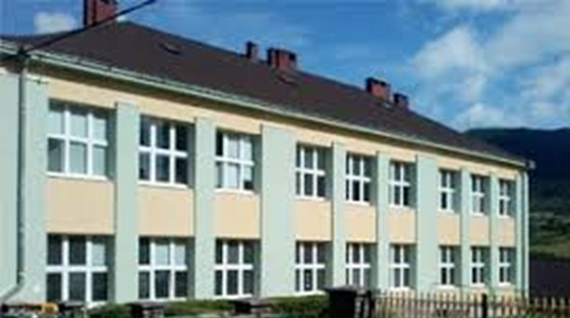
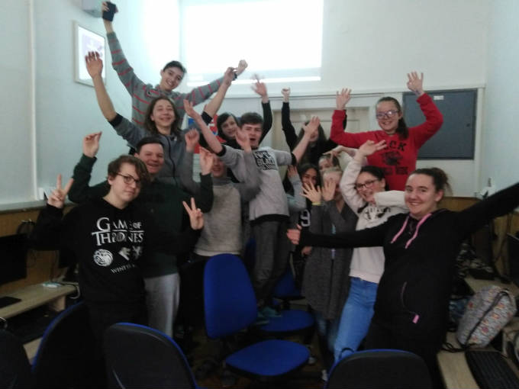
We attend Junior High School and
we are in the ninth grade
because we are 14/15 years old.
This is how our school looks like.
And here we are 9th grade great team ☺

Slide 4
Schedule
we have five types of schedule. Every day in a week we have got a different schedule but it lasts the whole school year.
one day we have got five lessons another day six or seven lessons.
our school subjects are: Mathematics, Slovak language, English language, German language, Biology, Chemistry, Physics i.e. Science, History, Geography, Physical Education, Art, Technical work, Religion, Civics
we have got only complusory subjects, we haven´t got any electives.
when we have got five lessons we finish at 12:10 p.m. but when we have seven lessons we finish at 2:20 p.m.

Slide 5
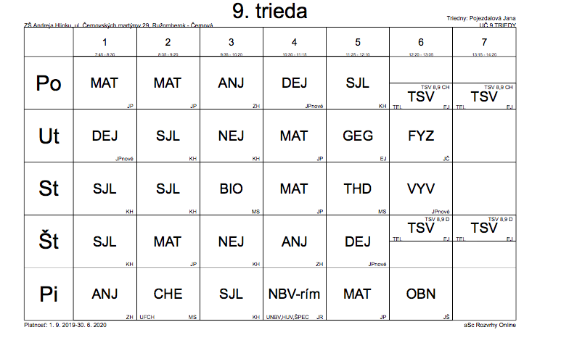
This is our schedule

Slide 6
Holidays
Our summer holidays lasts 2 months (July and August)
We also have a few other short breaks, like Fall (3 days),
Winter (12 days), Spring (a week) and Easter break (5 days).
We don't also go to the school during some public holidays e.g.
-Labor day,
-St. Peter and Pauls‘ day
-Anniversary of the Slovak National Revolution
and some others.

Slide 7
Marks and school report card
In our schools you can get marks from one (1) to five (5) .
One (1) is the best mark and five (5) is the worst mark.
We get school report card twice a year, once at half of the school year and the other at the end of the school year. Our school report card has not only got marks for subjects but also a mark for behaviour.
Marks at our school report cards are written by words :
Excellent is 1
Very good is 2
Good is 3
Sufficient is 4
Insufficient is 5

Slide 8
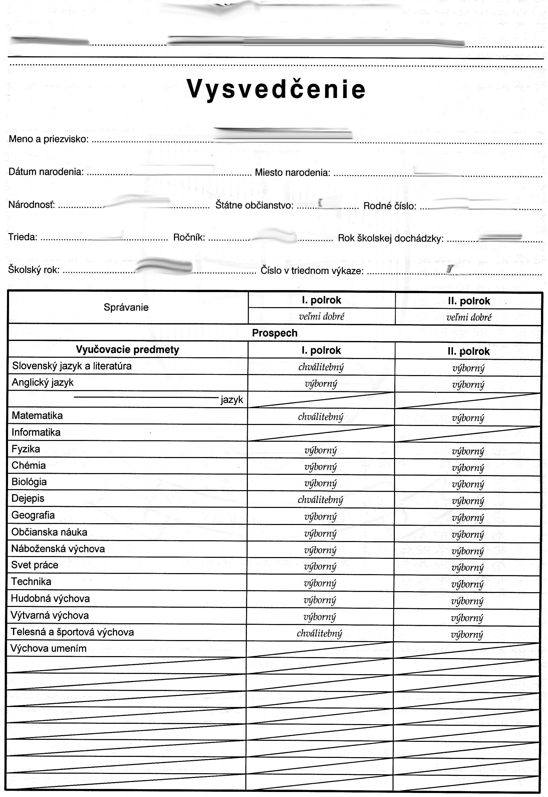
It looks like this:

Slide 9
Rewards and punishments
Rewards get those students, who have got all A‘s (1‘s) on their school report card and also the students, who have successfully participated at some competitions. They get the reward from their class teacher or a director and each of them gets also a book.
Punishments we usually get in our schools when we break some school rules . The teacher keeps a student in detention e.g. for not doing homework or for being too loud during the lessons.
If it is serious and our behaviour is inappropriate we can get worse mark at our school report card for our behaviour for example when a teacher sees us that we have got a mobile phone with us and we use it during the lessons.

Slide 10
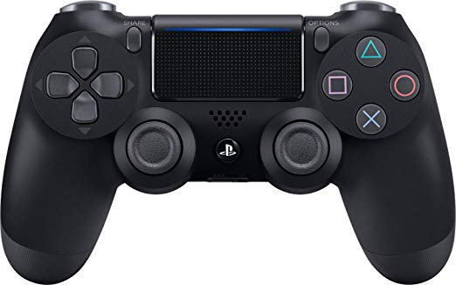
After school activities
When the school day ends, sometimes at 1 p.m. another time at 2 p.m. we hang out with our friends or we play PC games.
After school we sometimes go for a pizza or a drink (no alcohol).
Some of us have some after school activities like playing music, art or some sports‘ activities.
In the evening we do our homework, study for the tests or prepare some projects.

Slide 11
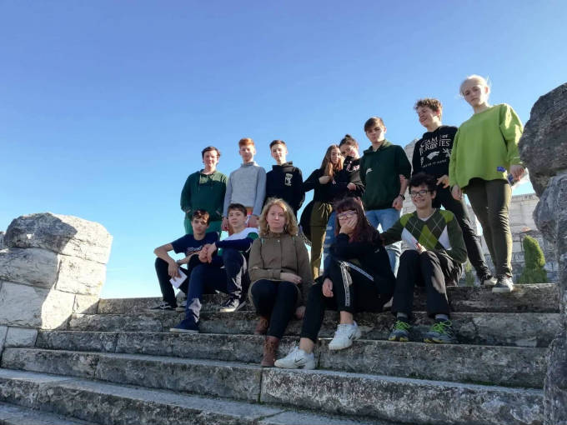
Thank you for your attention.

